Slide 1




Future Leaders EXchange AIDA ABZHAPAROVA 2016-2017 ILLINOIS, FREEBURG
Notes:
Add your picture from program, also insert your name/last name, program year and US city/state here for example: Natia Sharikadze FLEX 2007-2008 Jenison, Michigan

Slide 2
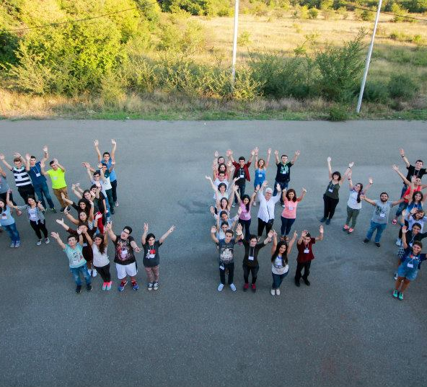
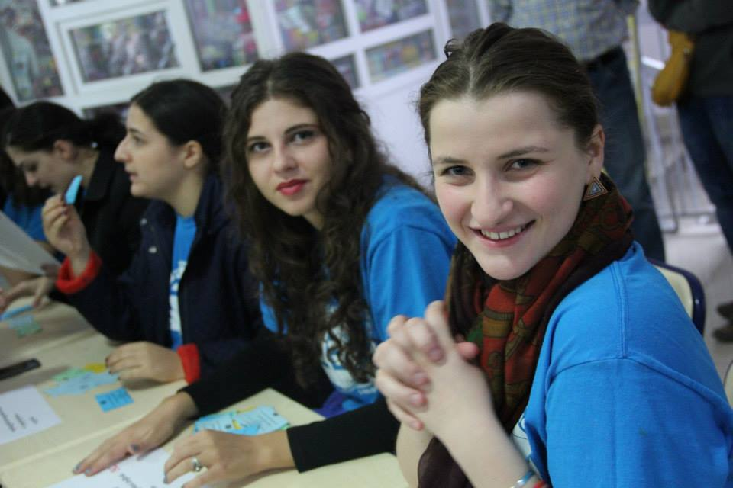
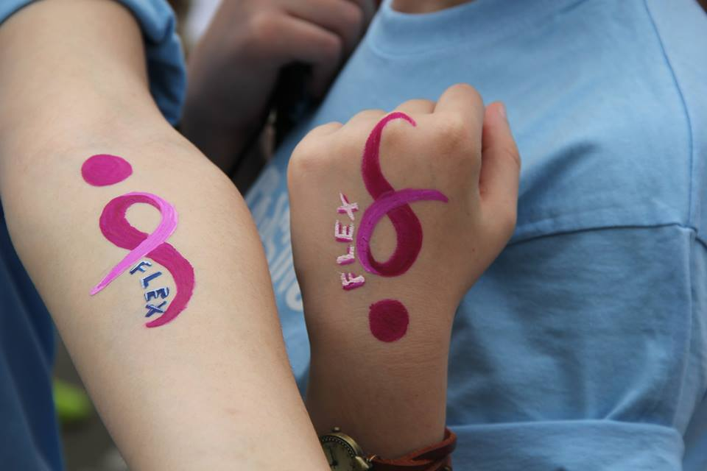
What is FLEX?
United States Department of State-sponsored program for secondary school students.
Established in 1992 and funding is provided through the U.S. Department of State's Bureau of Educational and Cultural Affairs.
Merit-based scholarships for students to travel to the United States, live with a host family, and attend a U.S. high school for a full academic year.
Notes:
Make sure you mention information on the slide. Feel free to change pictures if needed.

Slide 3
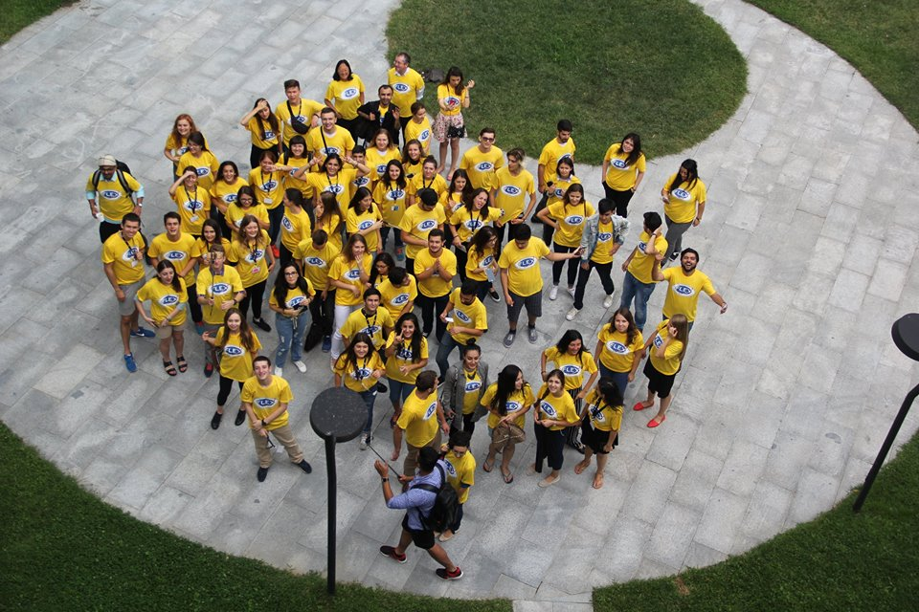
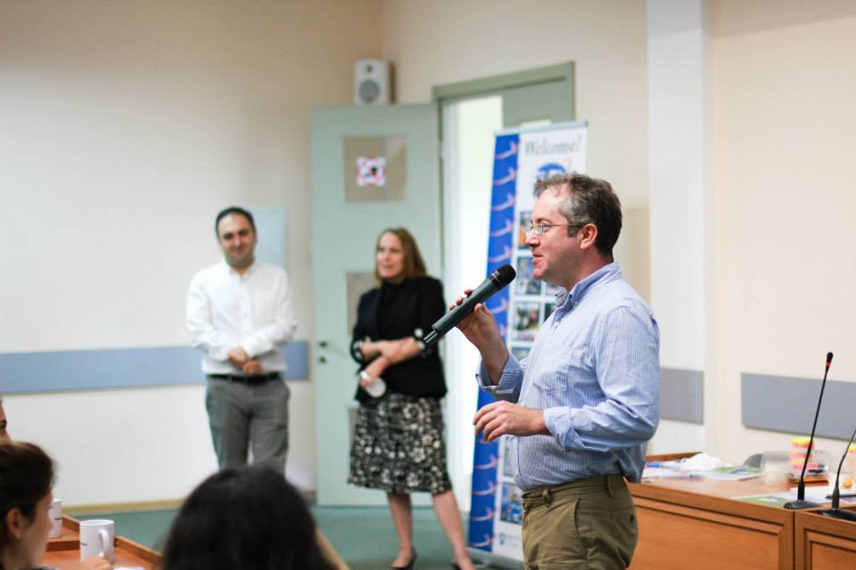
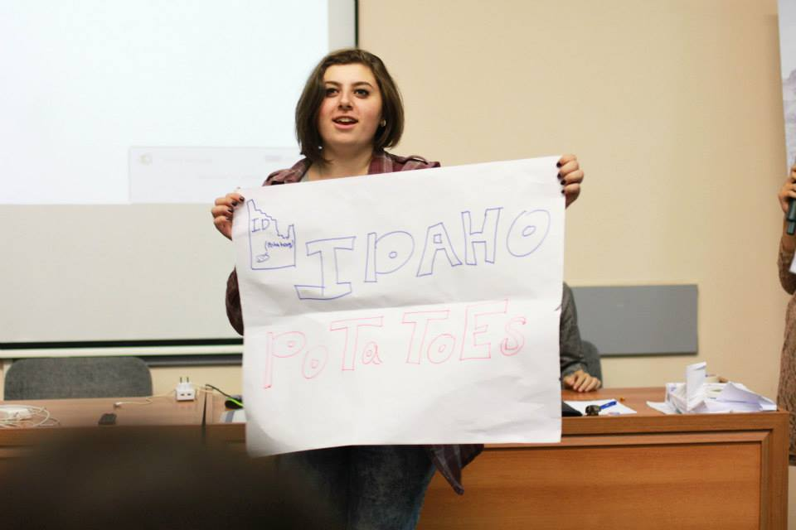
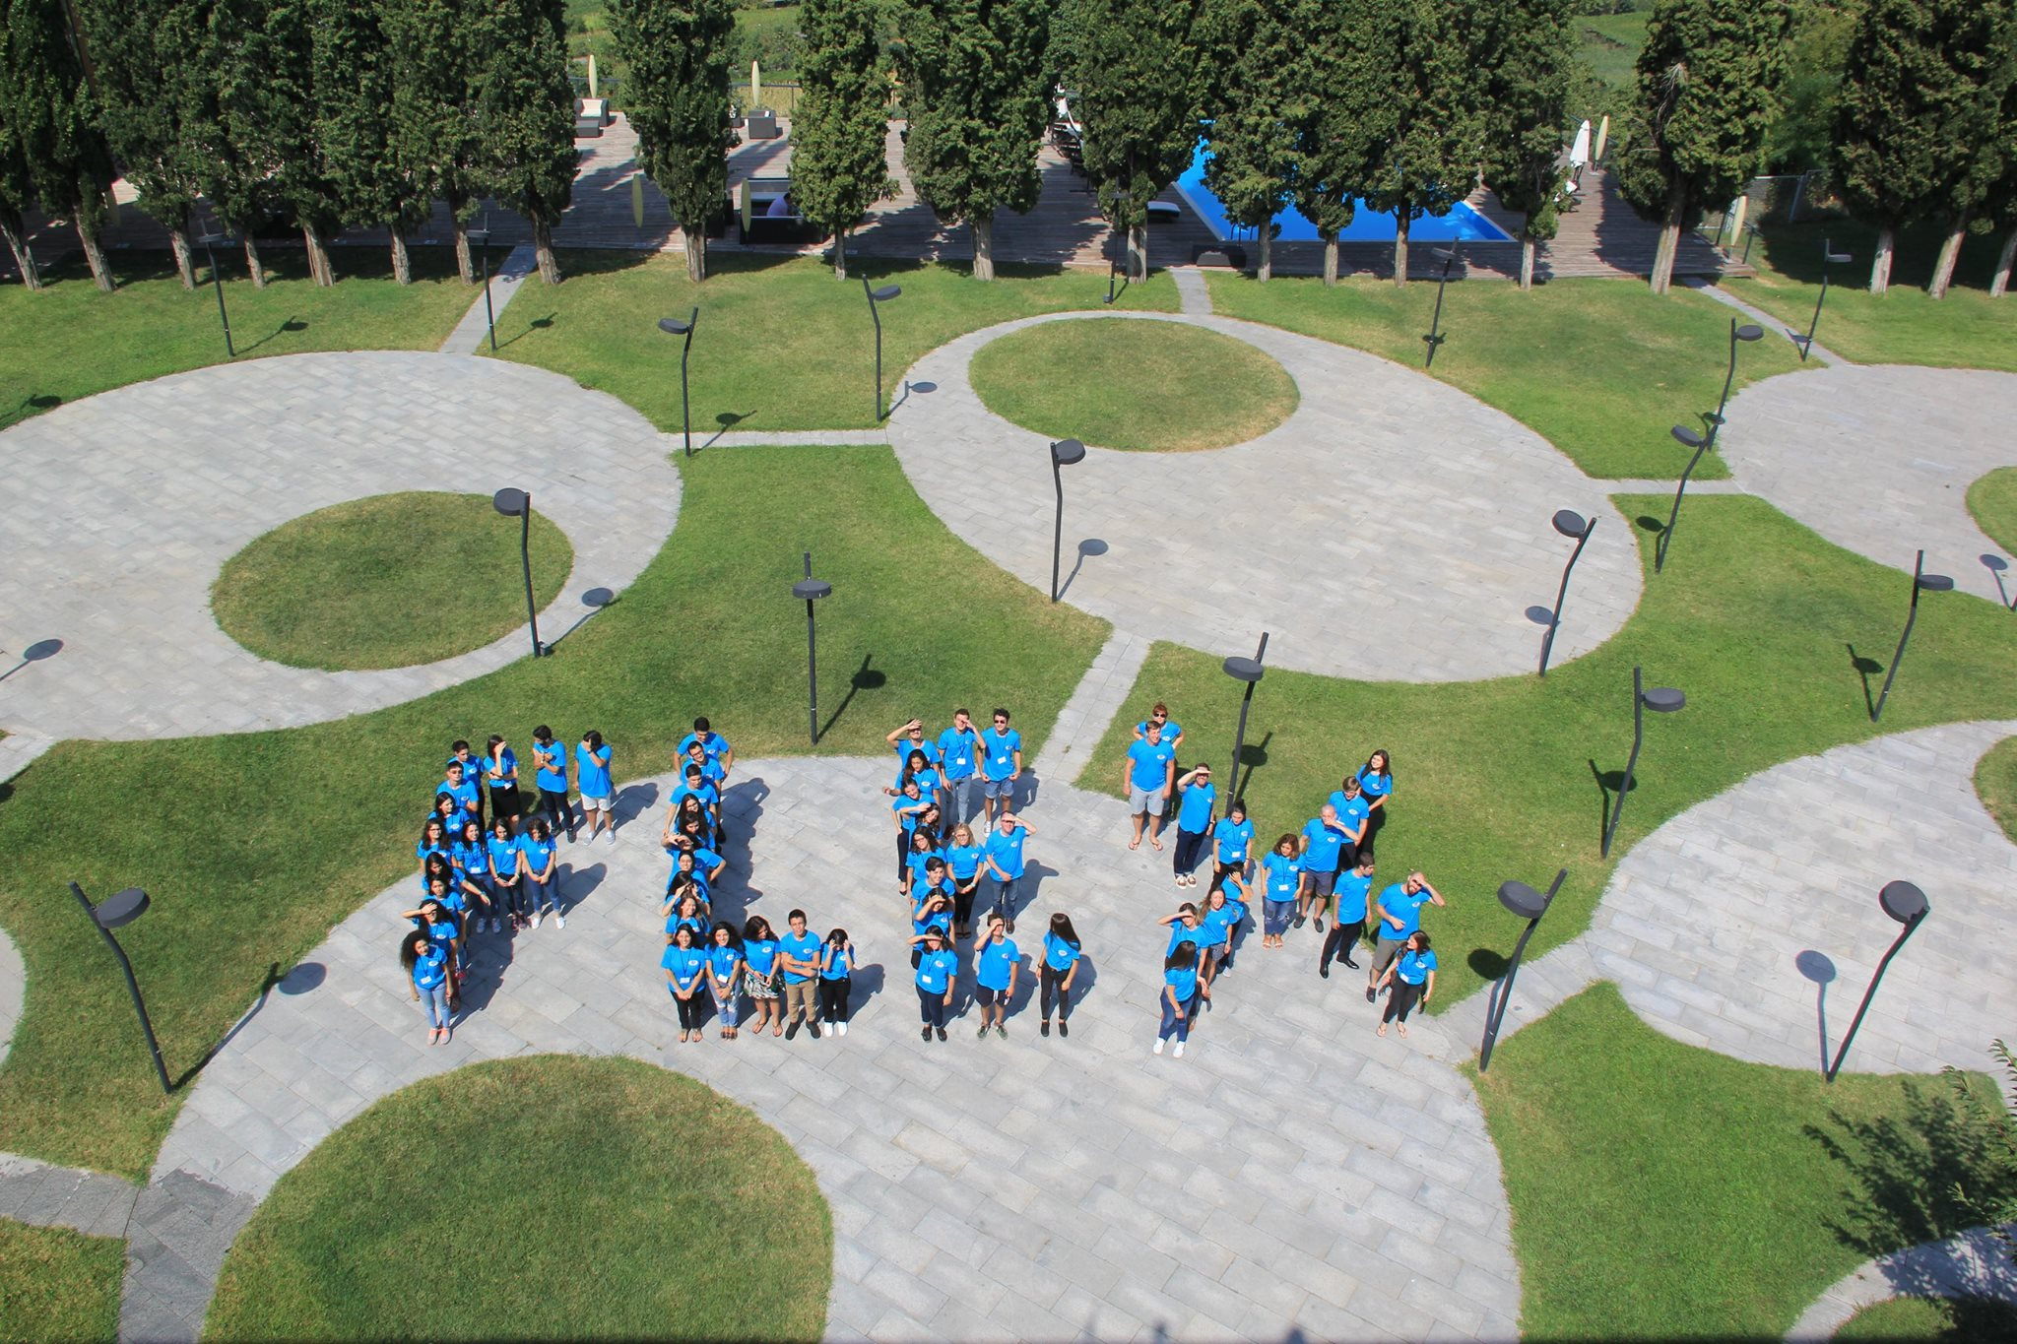
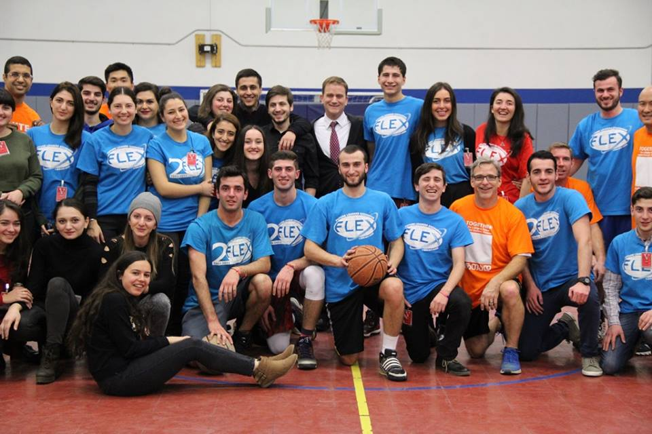
GOALS of FLEX
Interact with Americans and generate enduring ties.
Explore and acquire an understanding of the key elements of U.S. civil society.
Gain an understanding of American society, people, values, culture, diversity, and respect for others with differing views.
Teach Americans about your home country and culture.
Share and apply experiences and knowledge in your home country as alumni.
Notes:
Make sure you mention information on the slide. Feel free to change pictures if needed.

Slide 4
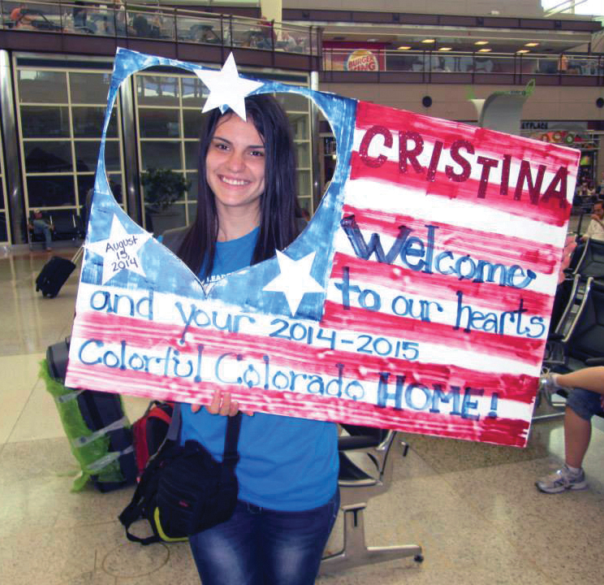
Eligibility
CAN:
To be enrolled in school, studying in 8th, 9th, or 10th grade, or 1st year of lyceum of college where the student enrolled after completing 9th grade.
Be born between 1 January 2002 and 15 July 2004.
Be enrolled in a secondary school at the time of application.
Have an academic standing of “good” or better
Have previously studied English and demonstrate English language ability at the time of registration.
Meet U.S. visa requirements.
Be a citizen of the country where he/she applies
CANNOT:
In the past 5 years has not resided in the US for 3 or more months
His/her family:
has applied or is applying to emigrate to the United States
has made plans to emigrate or has already emigrated to the United States.
Notes:
Please check this information with the office, especially the text in red. Feel free to change picture if needed.

Slide 5
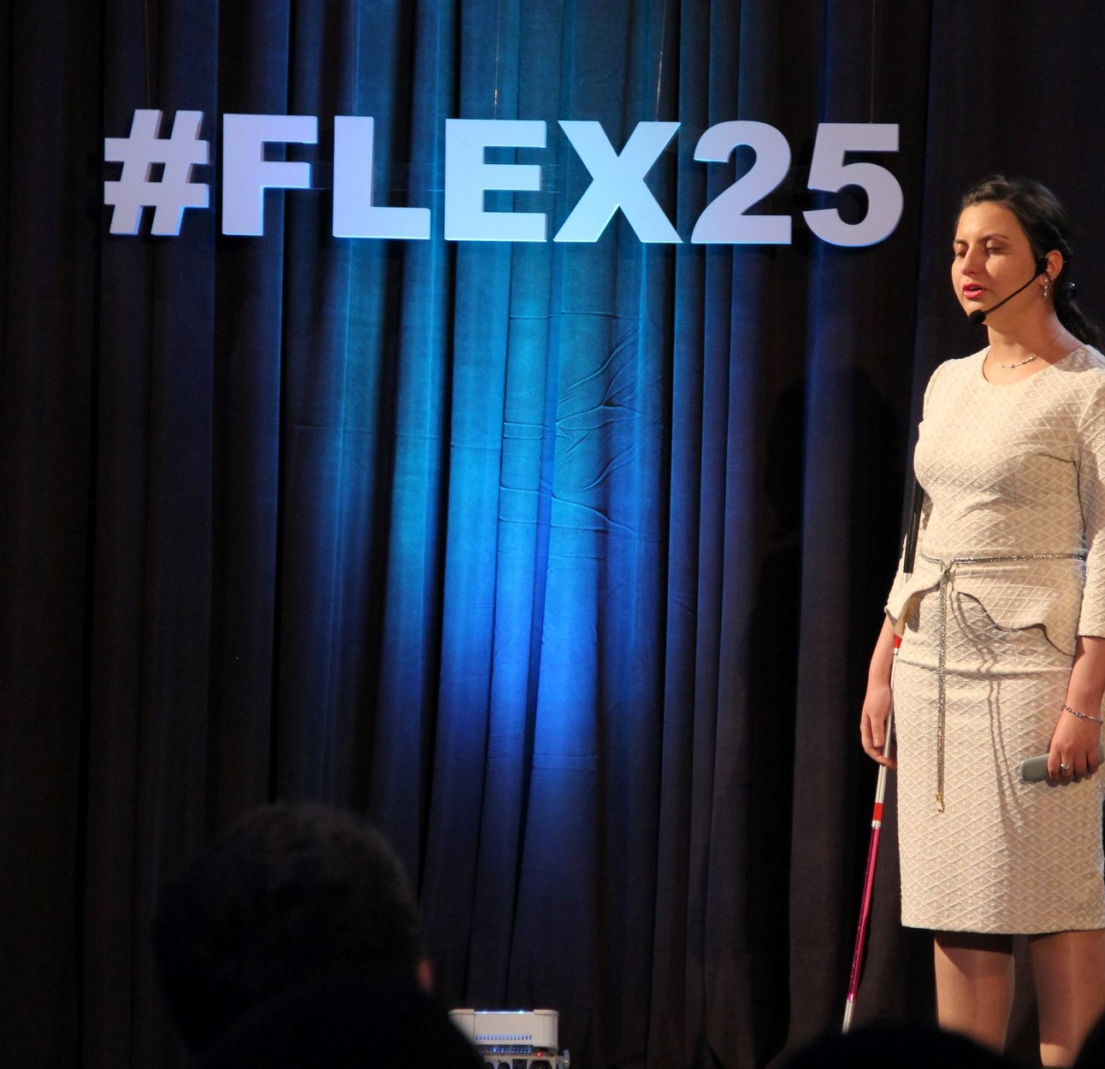
Students with Disabilities
The FLEX program can support students with disabilities and encourages their participation.
High school students with disabilities born between February 15, 2001 and 15 July 2004 are eligible to apply for FLEX
Notes:
Please check this information with the office, especially the text in red. Feel free to change picture if needed.

Slide 6
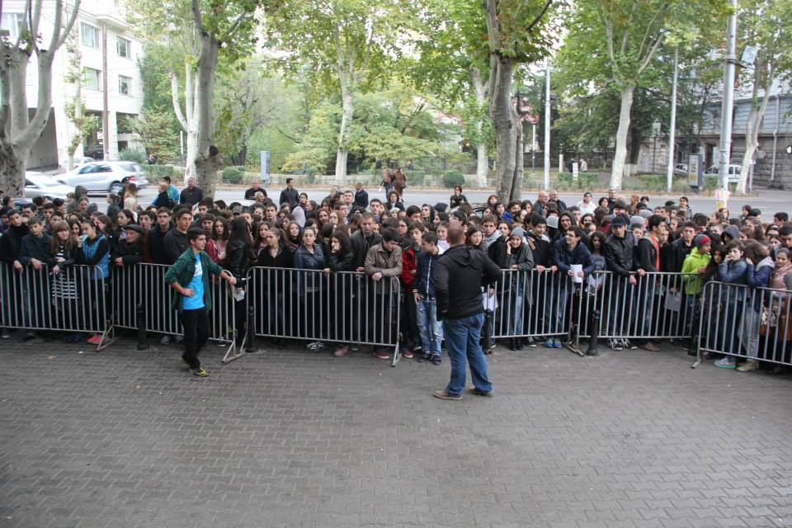
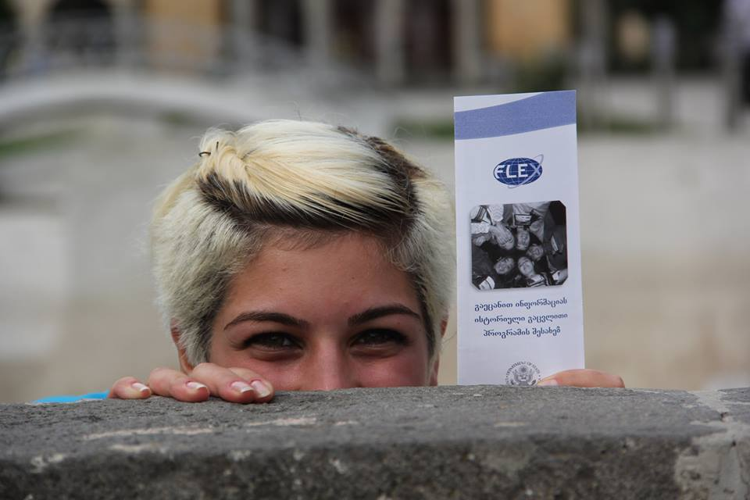
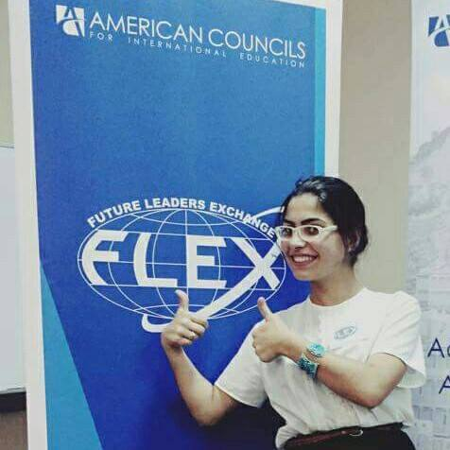
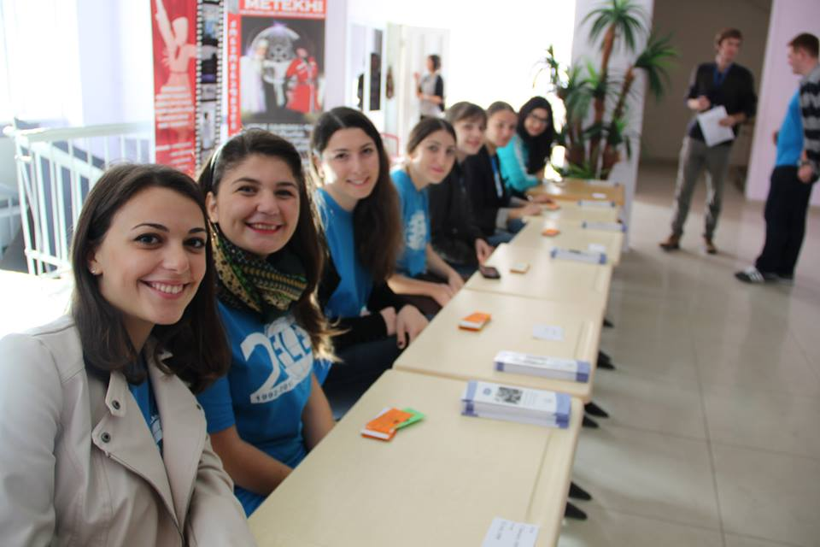
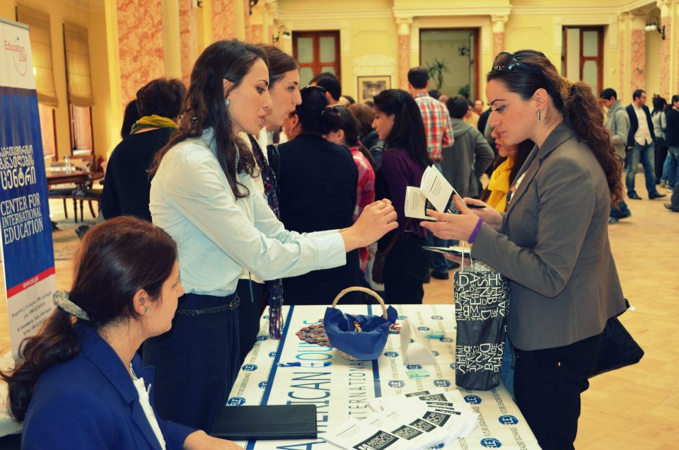
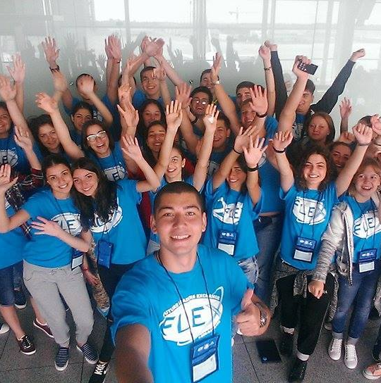
What Does the Scholarship Provide?
Monthly allowances to help students participate in social activities and buy necessary personal supplies
Program orientation activities including preparation for going on the program & for returning home
Support for alumni as they implement projects in their home communities
Round-trip international travel & medical insurance
Placement with a U.S. host family for one year & enrollment in a U.S. secondary school
Program activities arranged in U.S. communities
Notes:
Make sure you mention information on the slide. Feel free to change pictures if needed.

Slide 7
What Is NOT Provided?
International Passport
Personal Expenses
Excess Baggage Costs
Telephone Calls
Notes:
Make sure you mention following information
FLEX/YES program doesn’t cover costs of:
An international passport
Personal expenses beyond what is covered by the monthly stipend
Excess baggage costs
Telephone calls made from the U.S. to home or a Skype account

Slide 8
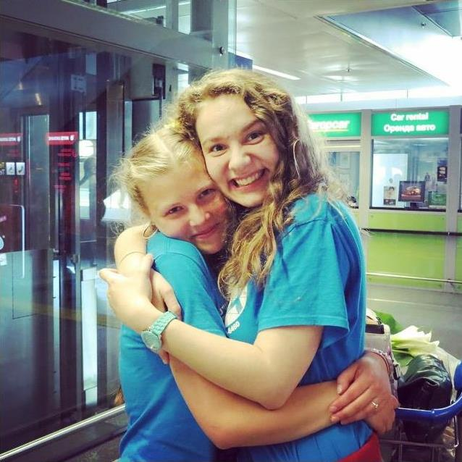
When? Where? How?
Students will be able to apply for the 2019-2020 program year in various cities around the country in fall 2018.
Exact testing locations will be available at www.americancouncils.kz in September 2018.
In order to participate in testing the student should have along:
original version of proof of eligibility (Birth Certificate, ID or Passport)
one recent photo 3x4 cm
Pen
Personal data release form signed by parent
Notes:
Please double check this information with the office. Feel free to change picture if needed. If applicable in your country add information about privacy policy.

Slide 9
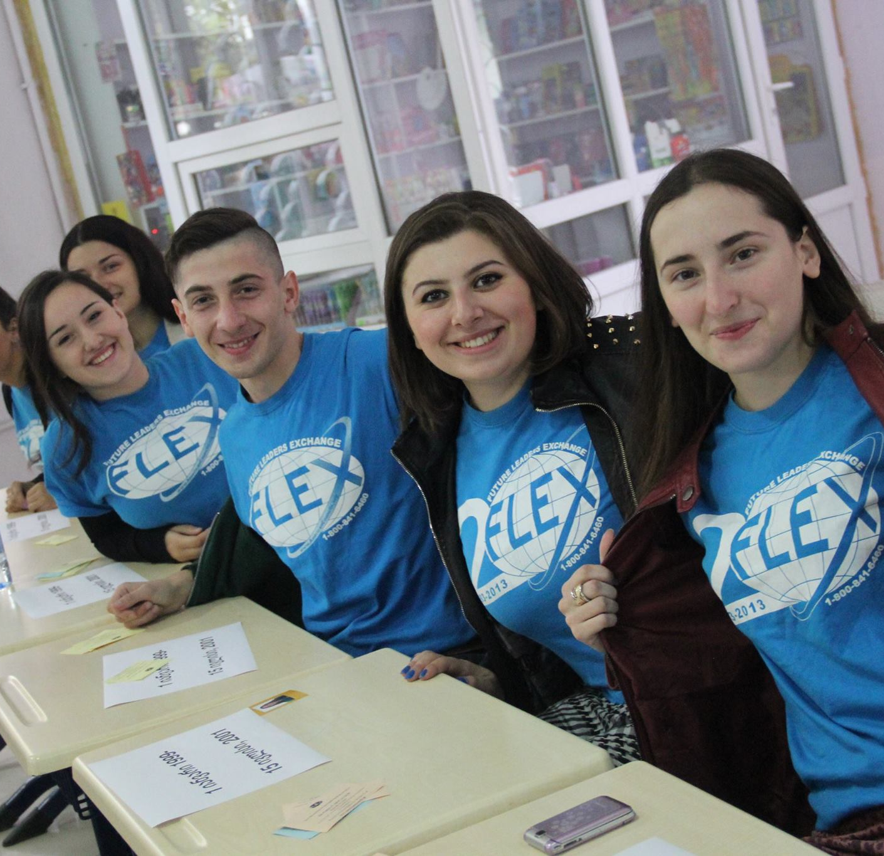
How does the testing look like?
Round 1:
15 minute English Test
Round 2:
Two essays
Round 3:
Longer English Proficiency Test, Application, Interview, Group Work.
Notes:
Please double check this information with the office. Feel free to change picture if needed or adjust if your country uses the online application.

Slide 10
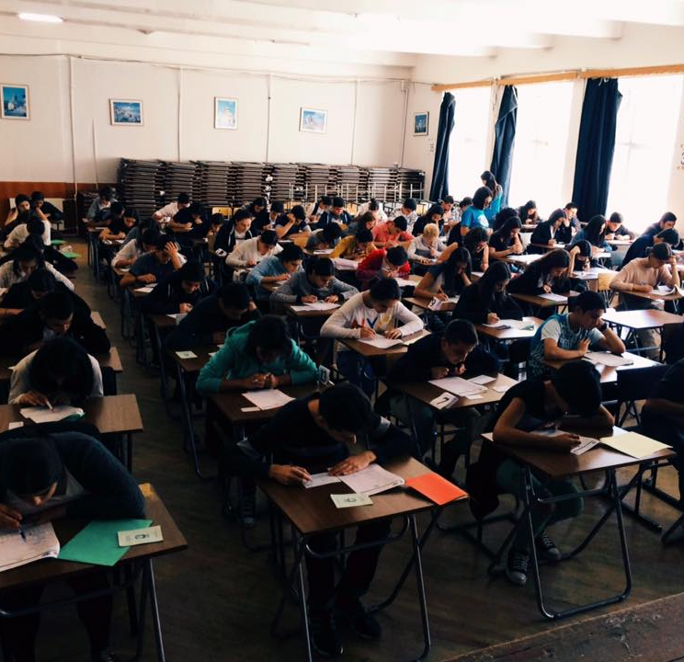
How are students selected?
Independent panels of American professionals select finalists and alternate candidates.
Selection is based on merit as evidenced in:
a face-to-face interview
essays written by the student
a comprehensive application
teacher references
Notes:
Make sure you mention information on the slide. Feel free to change picture if needed.

Slide 11
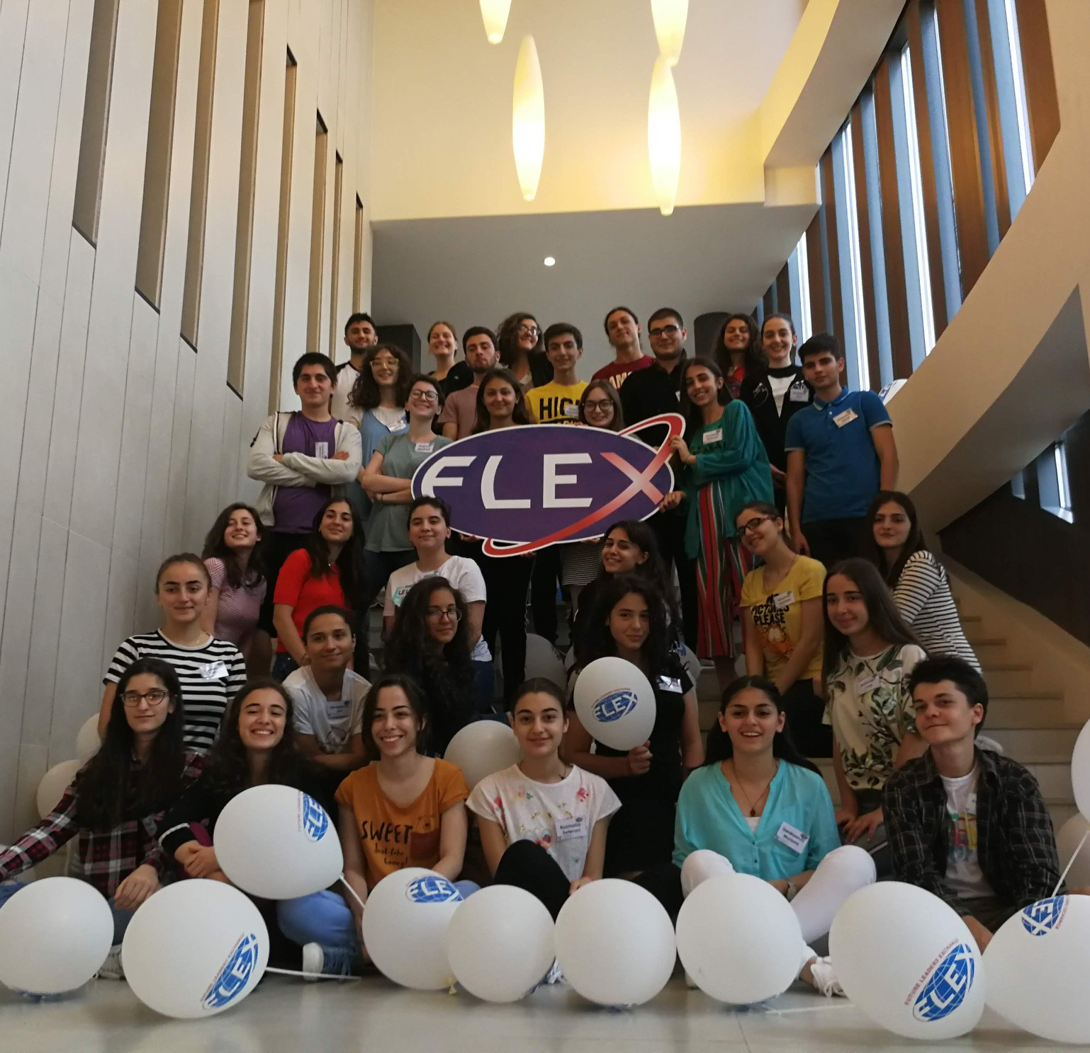
What Happens Next?
Upon notification, finalists, alternates and their parents receive materials to prepare them for departure.
Both finalists and alternates must notify American Councils that they accept the scholarship and provide any additional documentation requested.
Participants must begin the process of applying for an international passport and U.S. visa immediately.
From May through August, American Councils and its partner organizations match finalists with U.S. host families and arrange for school enrollment.
Notes:
Make sure you mention information on the slide. Feel free to change picture if needed.

Slide 12
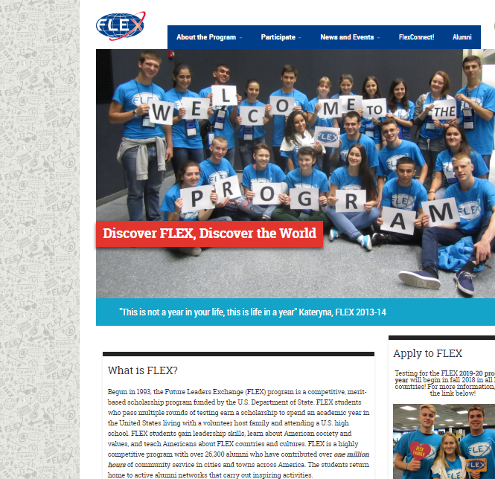

Where can I get more information?
www.discoverflex.org
www.americancouncils.kz
FB: https://www.facebook.com/AmericanCouncilsKazakhstan/?ref=bookmarks
Address: Kazibek bi 20a, Almaty, Kazakhstan
Notes:
Please update contact information with American Councils contact information in your country, and include other office resources such as phone number, Instagram, VK, etc. Feel free to change pictures if needed.

Slide 13
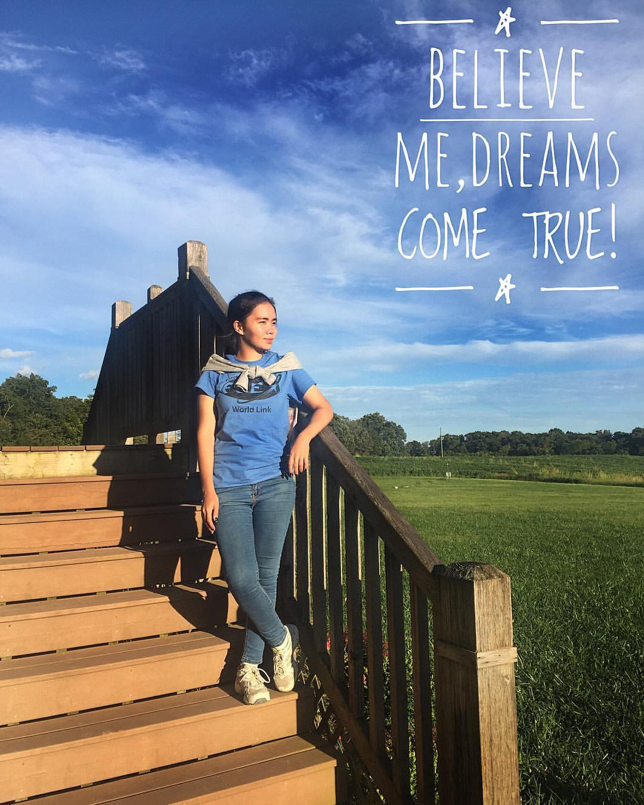
My FLEX Experience
What does FLEX mean to me:
Most Memorable Experience:
Benefit of my study abroad:
Or insert info about:
HF
School
Activities
Notes:
Add pictures from your experience in US. Preferable if the pictures that have a story. For example picture on this slide is Georgia team at Civic Education Week in 2017.

Slide 14
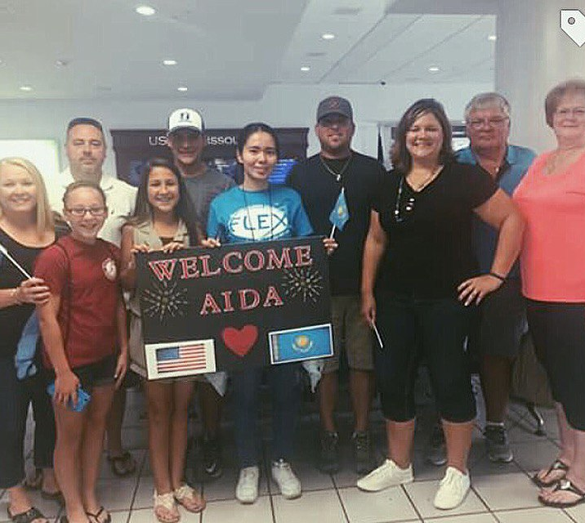
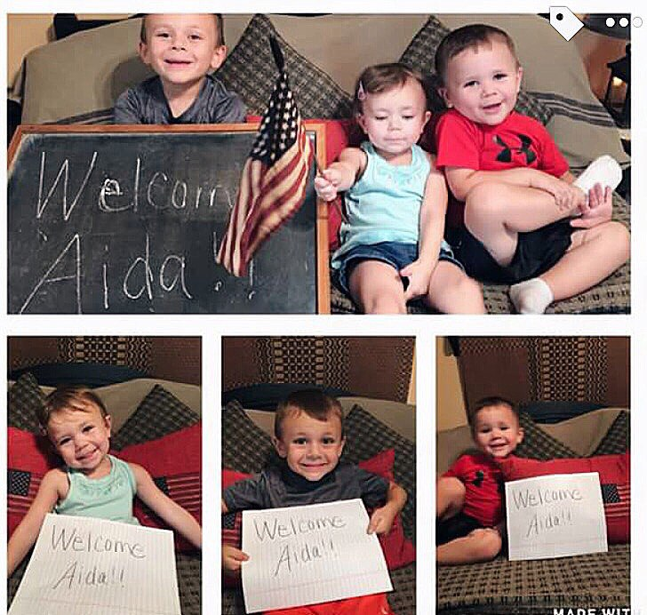
MY HOST FAMILY

Slide 15
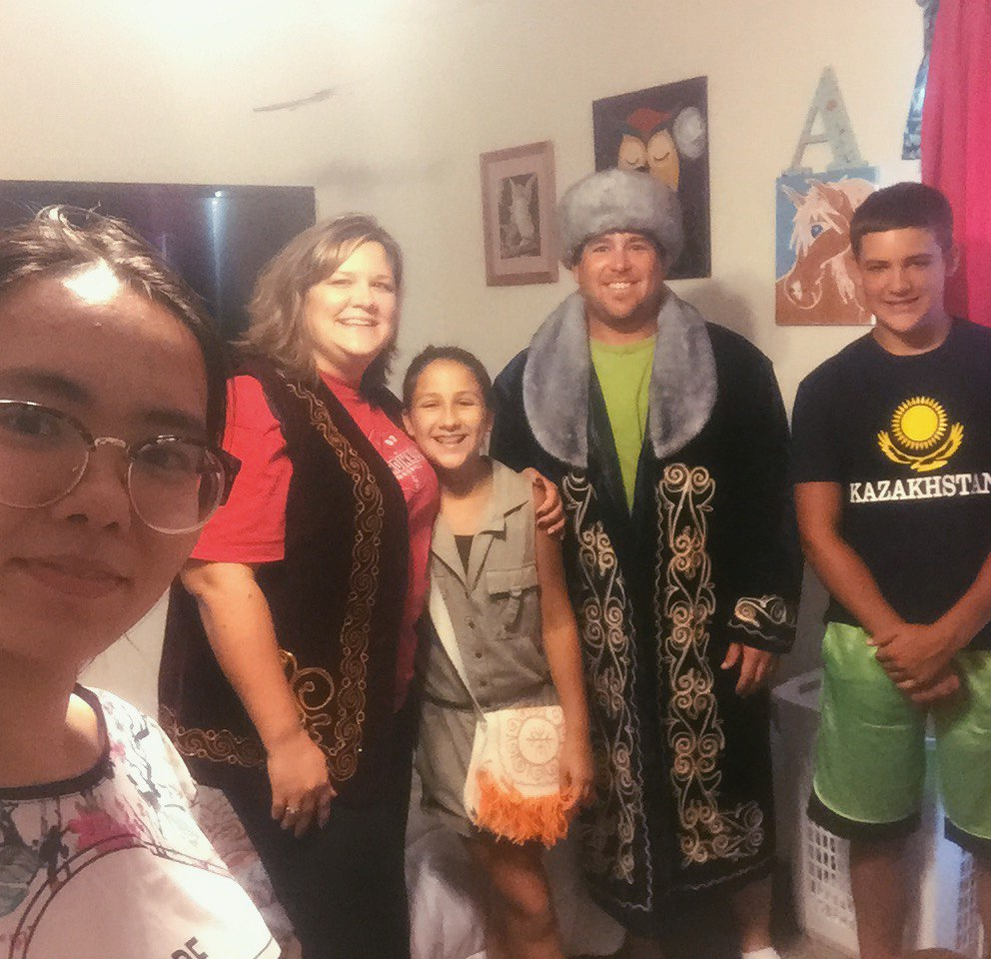
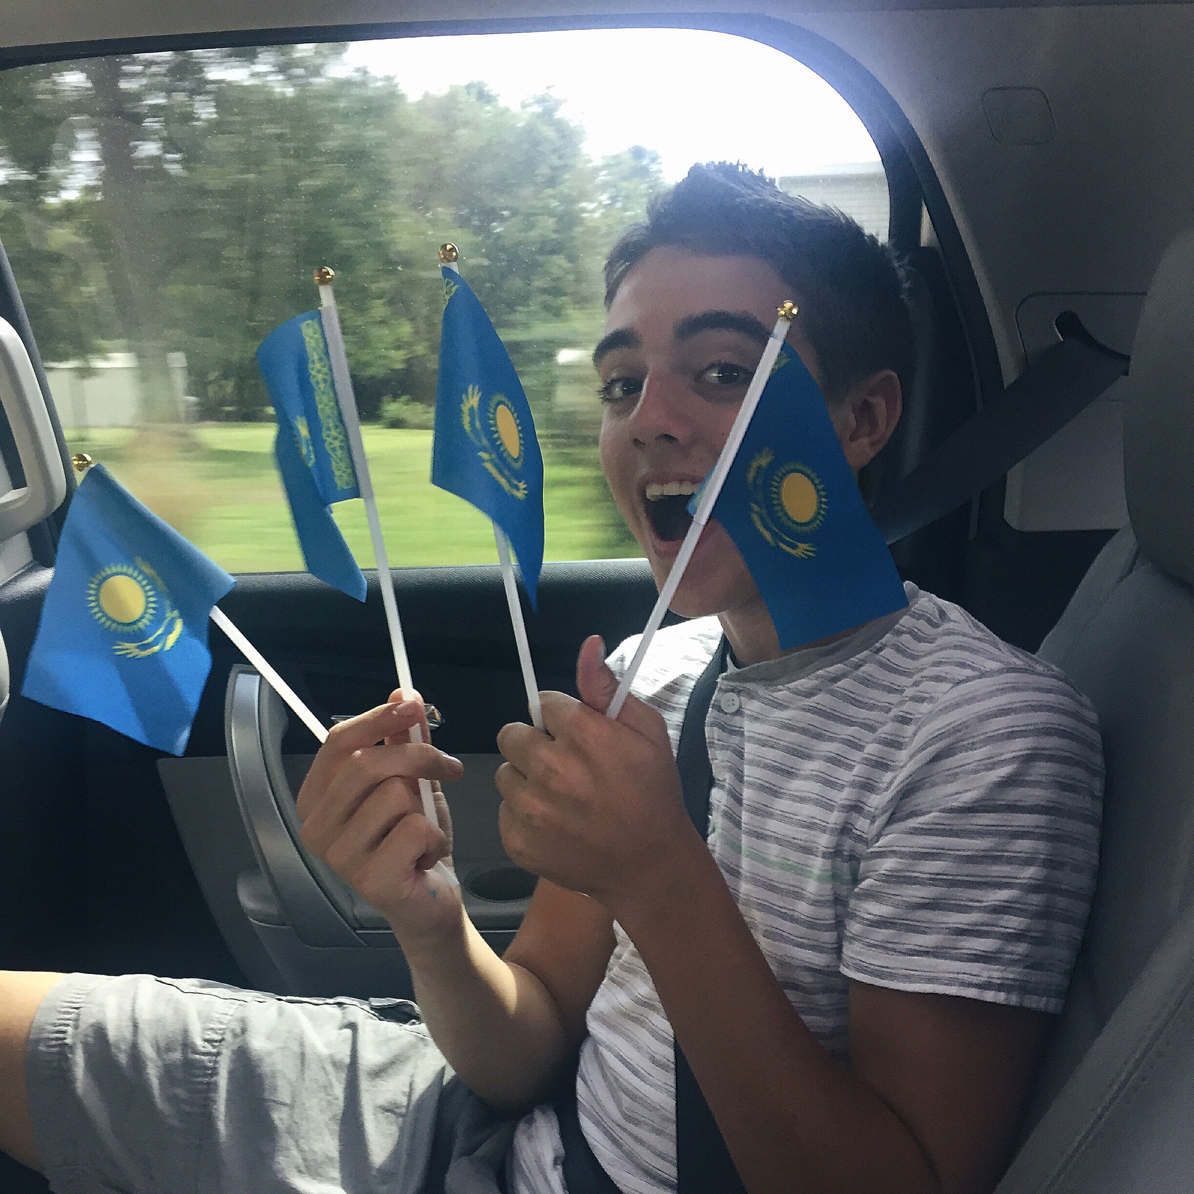

Slide 16
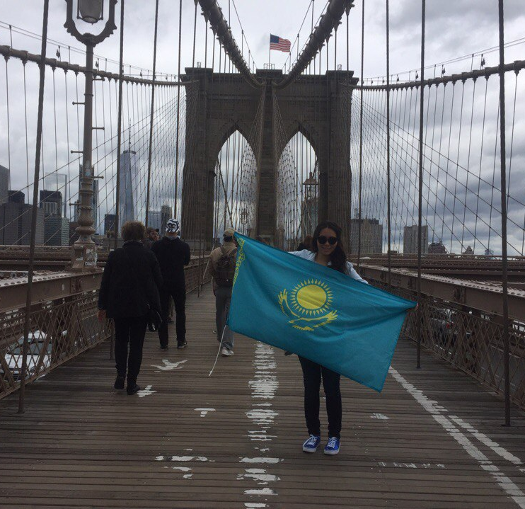
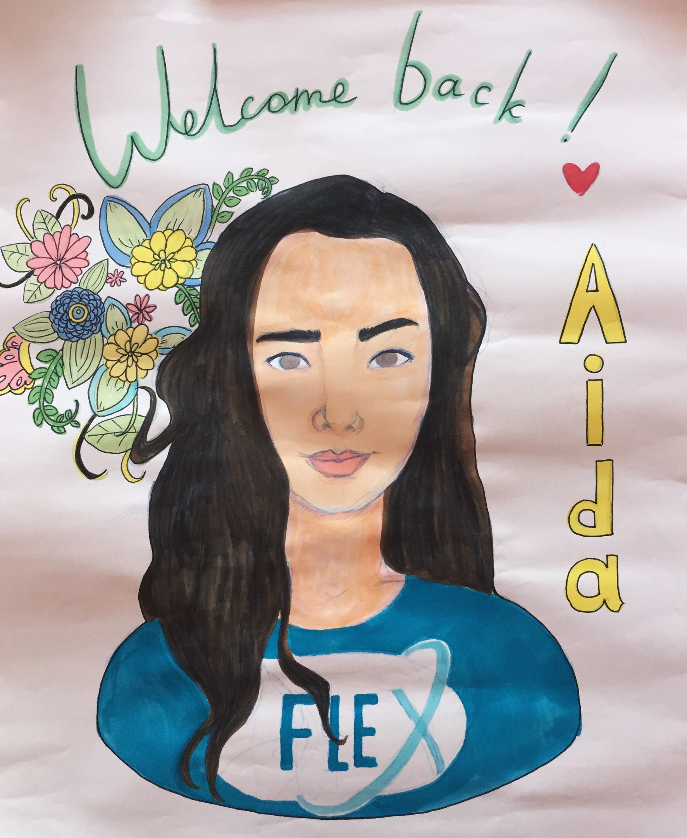
NEW YORK

Slide 17
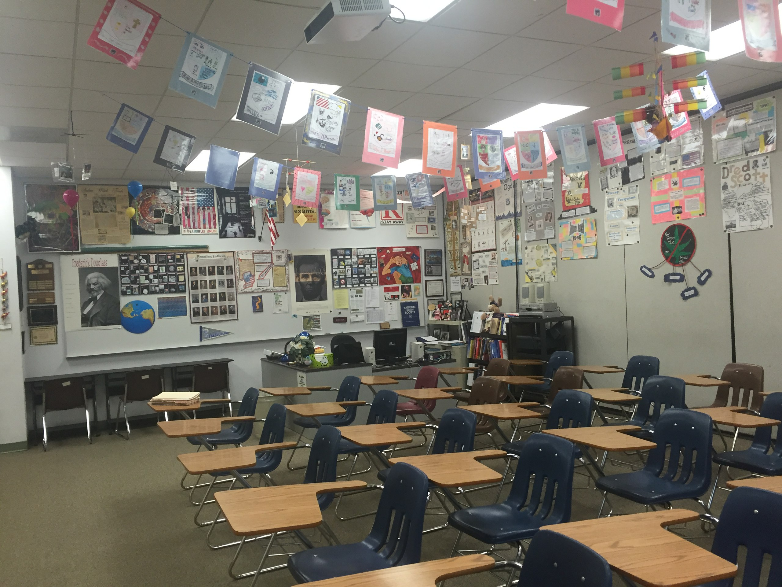
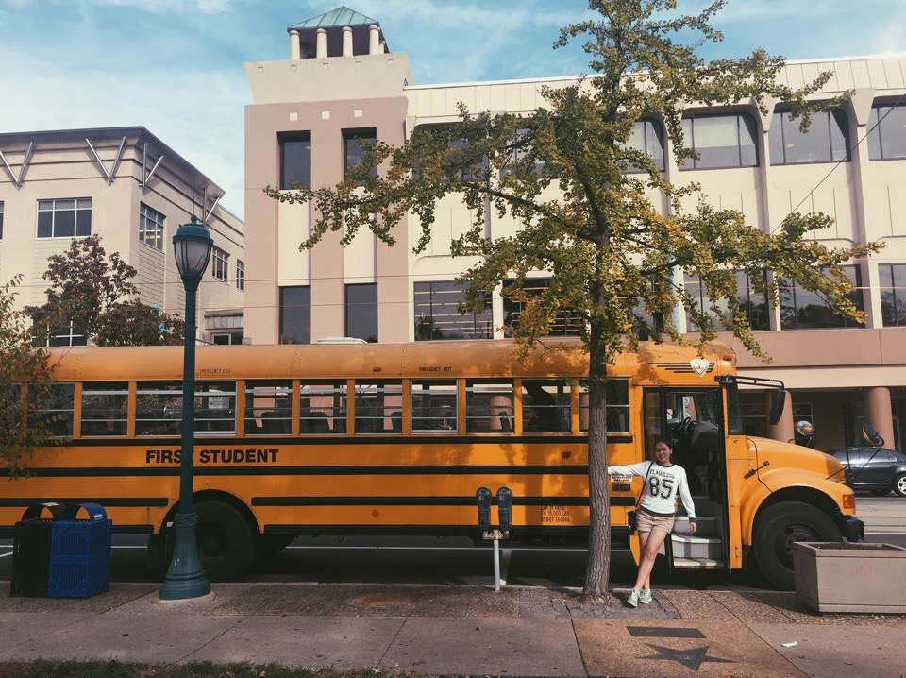
AMERICAN HIGH SCHOOL

Slide 18
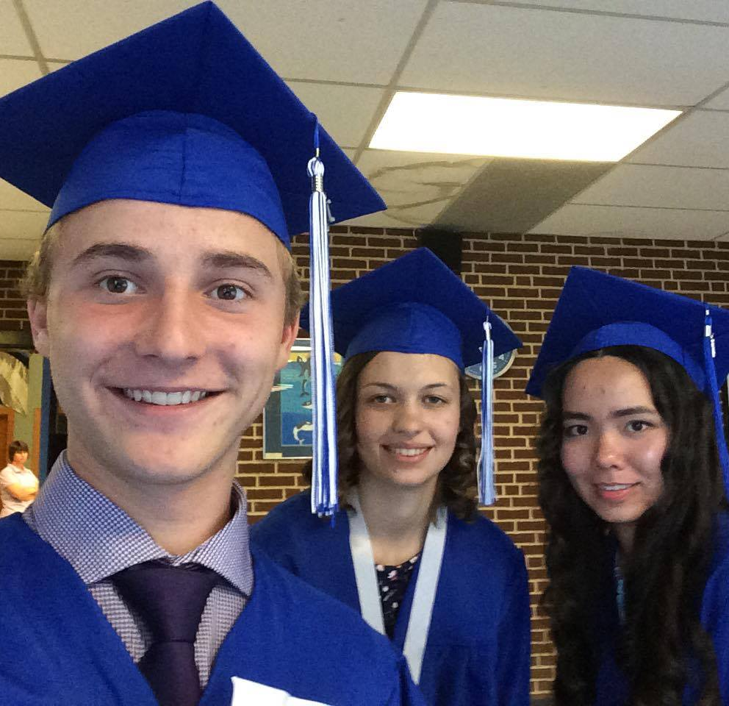
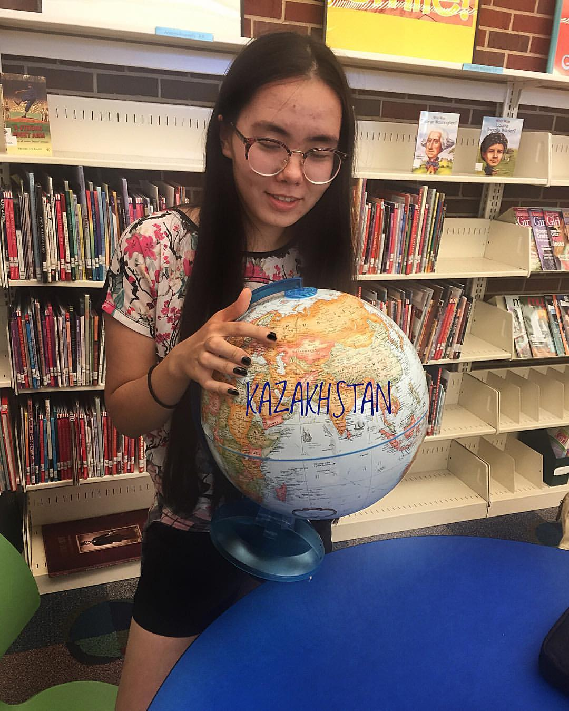

Slide 19
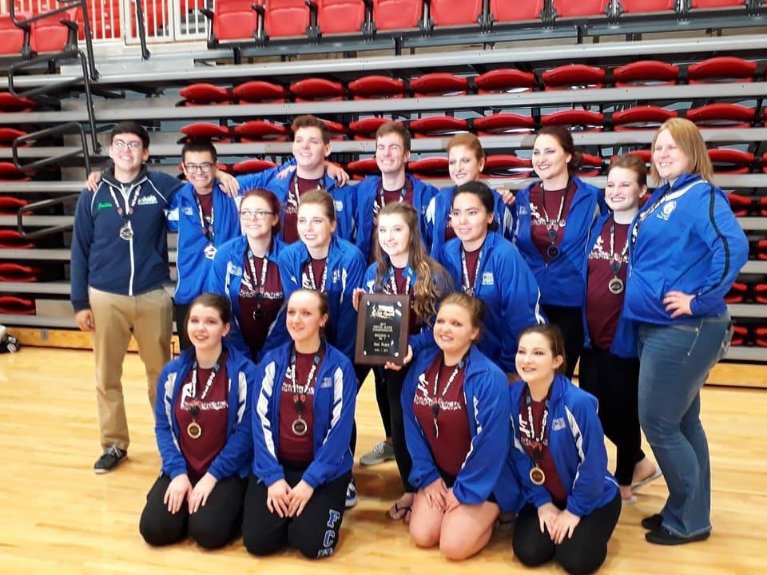
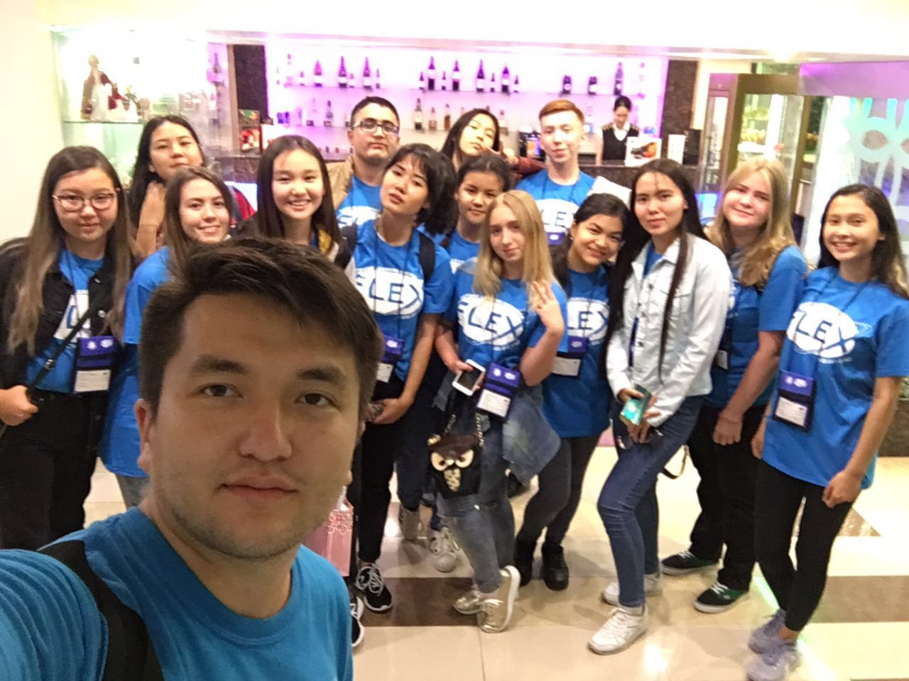

Slide 20
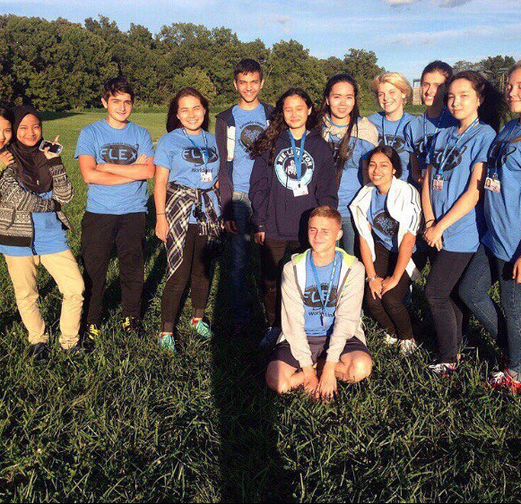
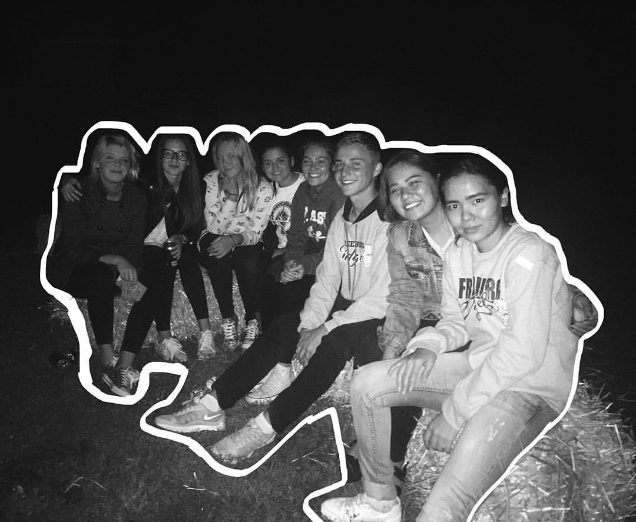
WORLD LINK ORG

Slide 21
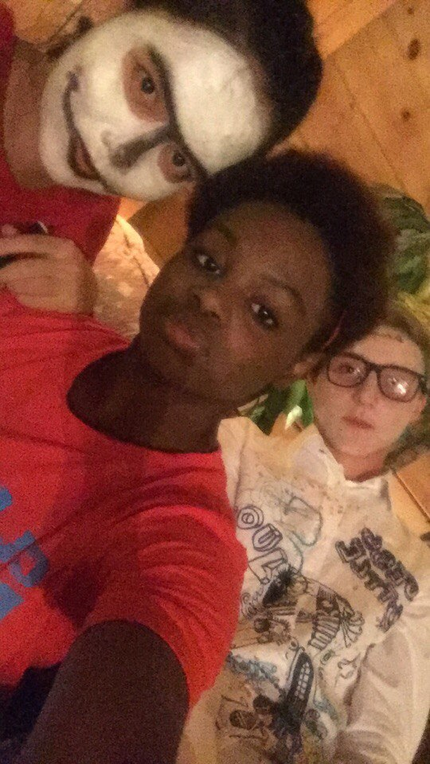
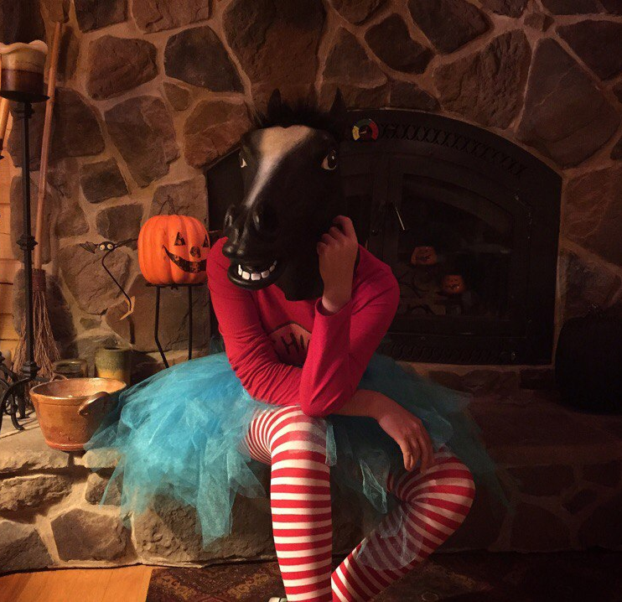

Slide 22
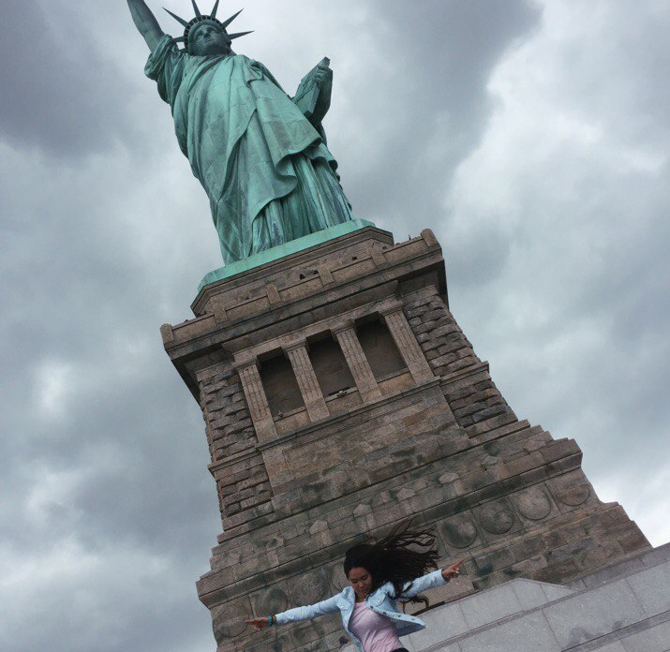
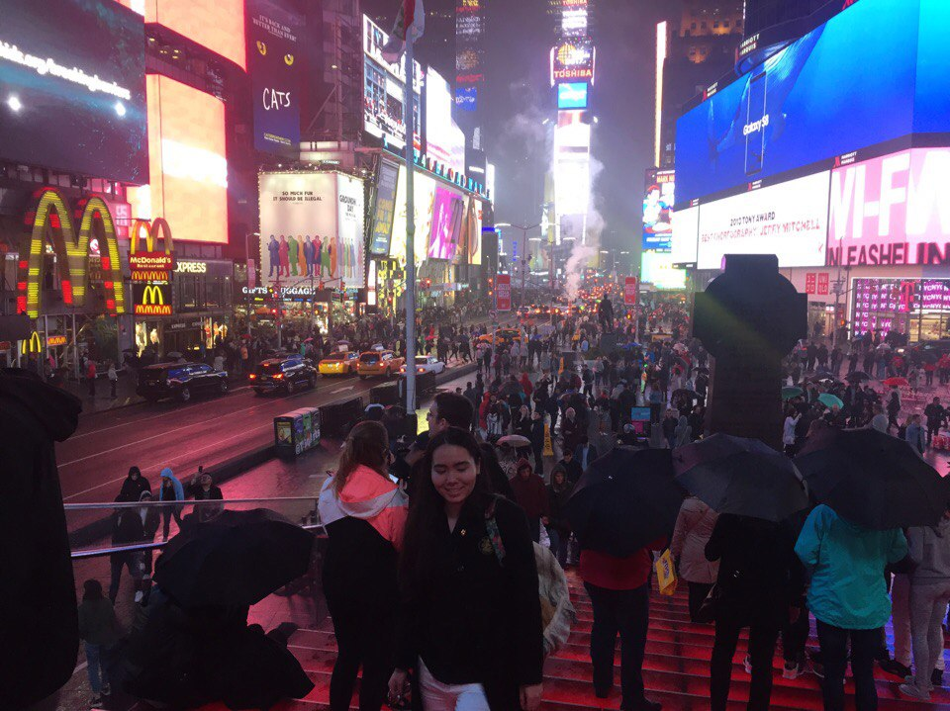
NEW YORK, TIMES SQUARE

Slide 23
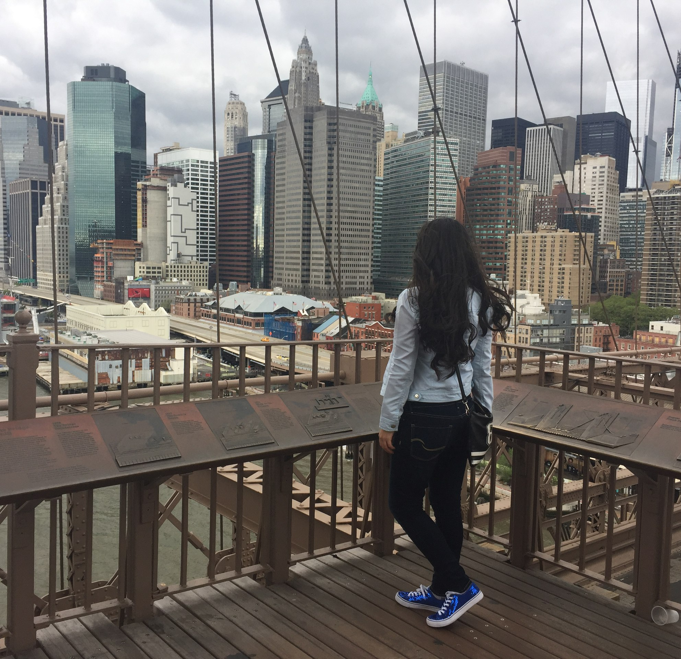
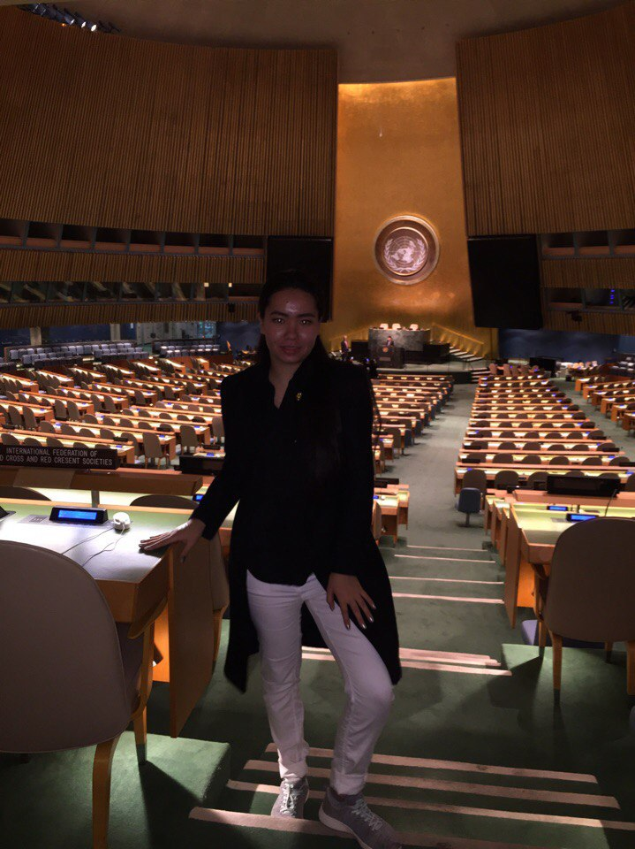

Slide 24
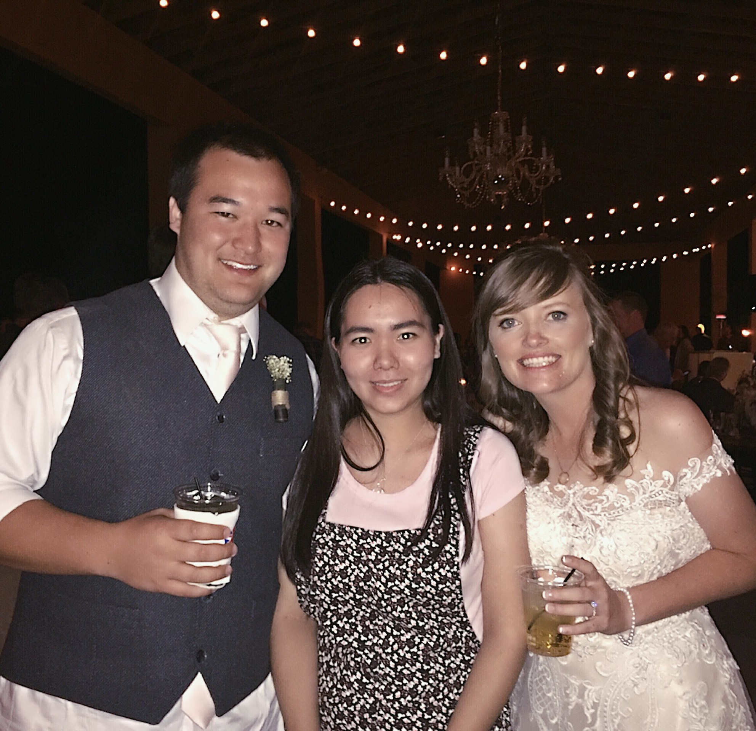
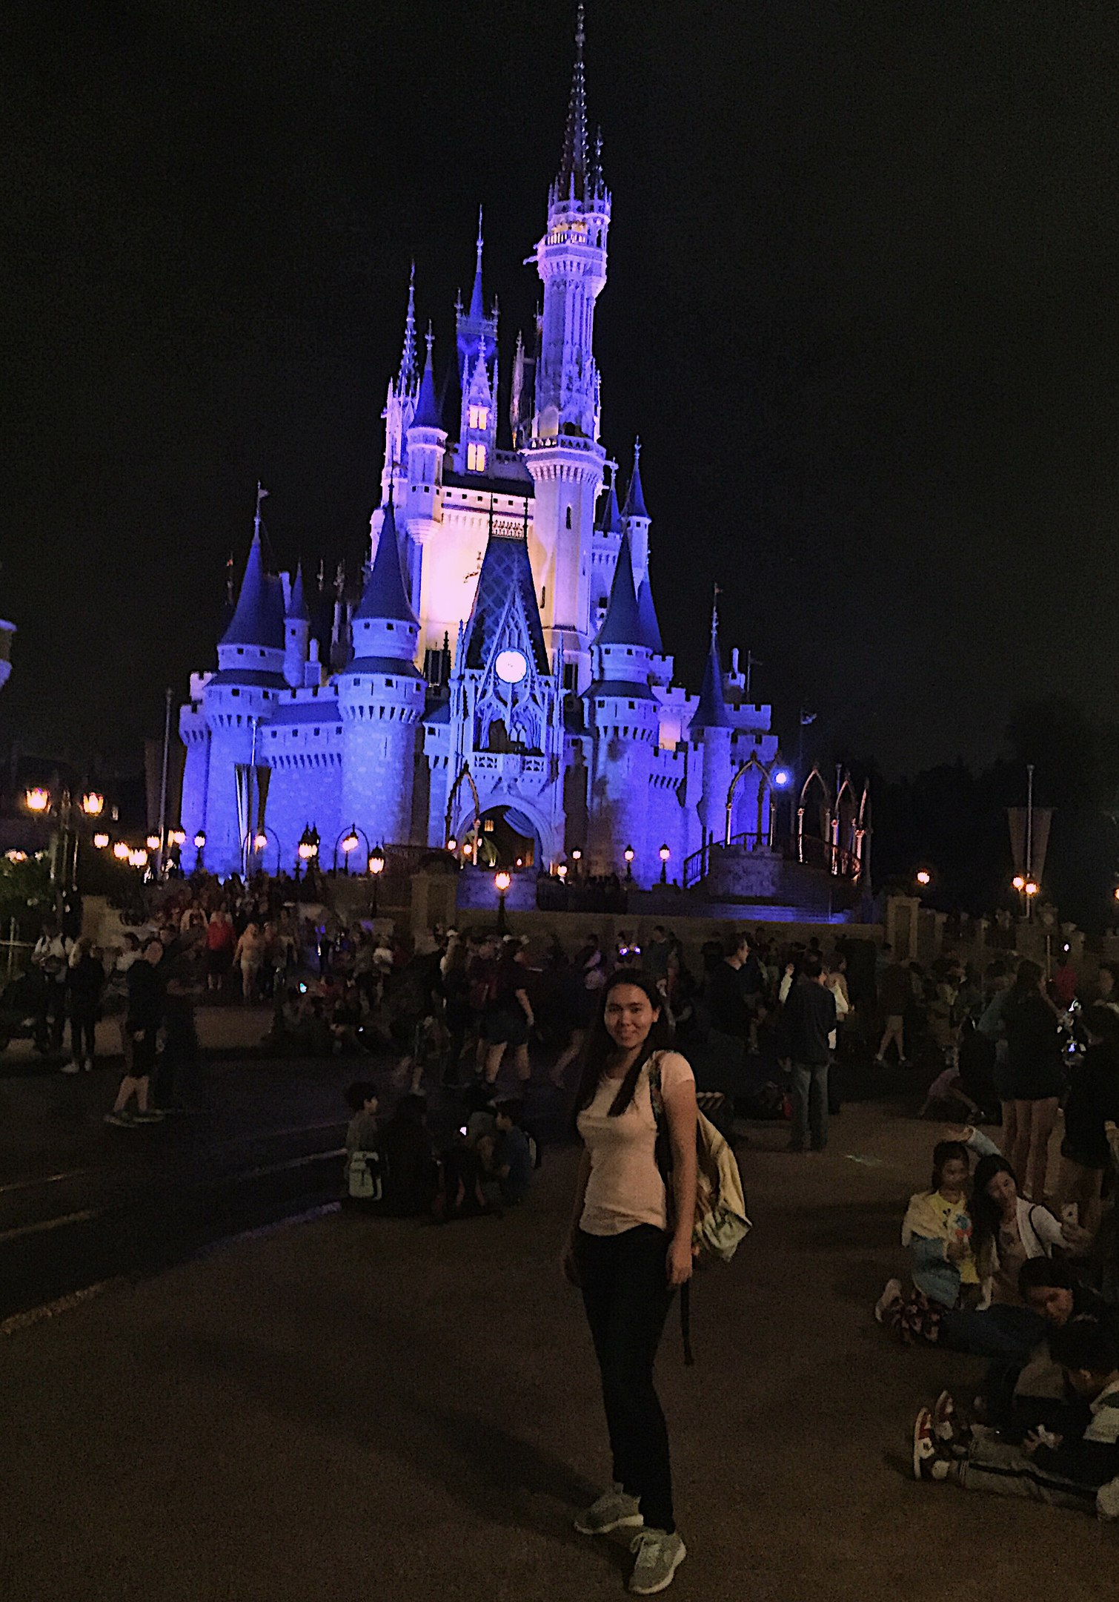
FLORIDA

Slide 25
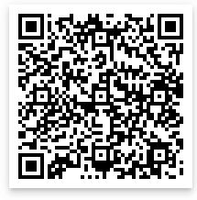
INSTA: ABZHAPAROVAAAA VK: AIDA ABZHAPAROVA EMAIL: abzhaparova.taraz@gmail.com telegram: abzhaparova
FOLLOW ME

Slide 26
Thank you for your attention and participation
NAME LASTNAME, FLEX 2017-2018

